Slide 1
Modern Portfolio Theory: Building an Optimised Stock Portfolio
George Chadwick-Jones
Mean-variance optimisation and risk based portfolio allocation

Slide 2
Investment Objective
A young client has a substantial amount of money to invest but is uncertain how to balance their portfolio so that it balances risk with return.
Objective
Select a diverse range of stocks across different sectors and industries.
Analyse historical returns, volatility and covariance/correlation to understand how the stocks move in relation to one another.
Optimise portfolio allocations using Mean Variance Optimisation to identify efficient risk vs return combinations.
Create portfolio options for different levels of risk tolerance.

Slide 3
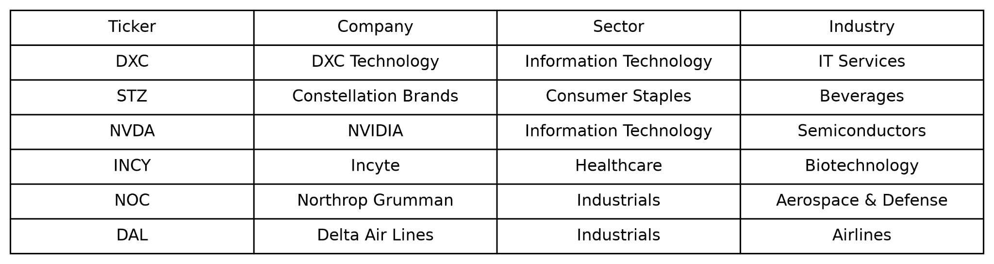
Stock Selection
The portfolio consists of 6 stocks selected from different sectors and industries. The table shows the companies included in the analysis and their respective sectors and industries.
The stocks were selected based on their historical returns, risk and correlation characteristics. Combining stocks from different companies and sectors allows for diversification and reduces covariance as the returns rely upon different industries.
The selected stocks were: DXC Technology, Constellation Brands, NVIDIA, Incyte, Northrop Grumman and Delta Air Lines.

Slide 4
DXC Technology (DXC)
Sector: Information Technology
Industry: IT Services
DXC Technology is a worldwide provider of information technology (IT) services and consultancy that assists government organisations and big businesses in managing, modernising, and operating their vital systems.
Why was it selected?
DXC gives exposure to the IT industry while diversifying away from the portfolio’s other technology holding, NVIDIA.
DXC and Anthropic announced a partnership in June 2026 to integrate Claude AI into enterprise systems. This partnership could strengthen DXC’s position in the growing AI market and create new opportunities for revenue growth.

Slide 5
Constellation Brands (STZ)
Sector: Consumer Sales
Industry: Beverages
Constellation Brands is a major beverages company whose portfolio includes beer, wine and spirits brands. Some of its most well known brands are Mondelo, Corona and Pacifico.
Why was it selected?
Diversifies the portfolio away from technology
The company’s exposure to established consumer brands provides a different source of potential returns.

Slide 6
NVIDIA (NVDA)
Sector: Information Technology
Industry: Semiconductors
NVIDIA is a leading technology company best known for its GPUs. Its hardware and software have become central to artificial intelligence, data-centres and gaming.
Why was it selected?
NVIDIA has continued to experience high demand for its products given the boom in artificial intelligence and data centres. Its AI chips and platforms are being adopted by major technology companies and cloud service providers as they expand their AI infrastructure.
Has historically high returns, giving the potential for higher earnings but also has greater individual stock risk.

Slide 7
Incyte (INCY)
Sector: Healthcare
Industry: Biotechnology
Incyte is biopharmaceutical company focussed on discovering, creating and commercialising medicines for serious illnesses. It has a particular focus on oncology and inflammatory conditions.
Why was it selected?
Incyte offers diversification away from technology and and consumer staples based industries by expanding the portfolio into healthcare and biotechnology. Its performance is influenced by pharmaceutical research, clinical development and demand for its treatments, giving the portfolio exposure to different market factors.

Slide 8
Northrop Grumman (NOC)
Sector: Industrials
Industry: Aerospace and Defence
Northrop Grumman is an aerospace and defence company that develops advanced systems for the US government and military including aircraft, space systems and autonomous technology.
Why was it selected?
Northrop Grumman gives exposure to the aerospace and defence industry, which is influenced by government programmes and long-term project as opposed to consumer or technology demand. This helps to give the portfolio another source of returns and reduces its reliance on consumer habits, which are liable to change with the economy.

Slide 9
Delta Airlines (DAL)
Sector: Industrials
Industry: Airlines
Delta is one of the world’s largest airlines, offering transportation for both passengers and cargo. It has an extensive domestic and international network, with its revenue being strongly influenced by travel demand, fuel costs and the wider economy.
Why was it selected?
Delta gives exposure to the airline industry, giving the portfolio an asset that is influenced by travel demand, fuel prices and wider economic conditions. These factors differ from market forces that impact the technology, healthcare and defence sectors, providing additional diversification.

Slide 10
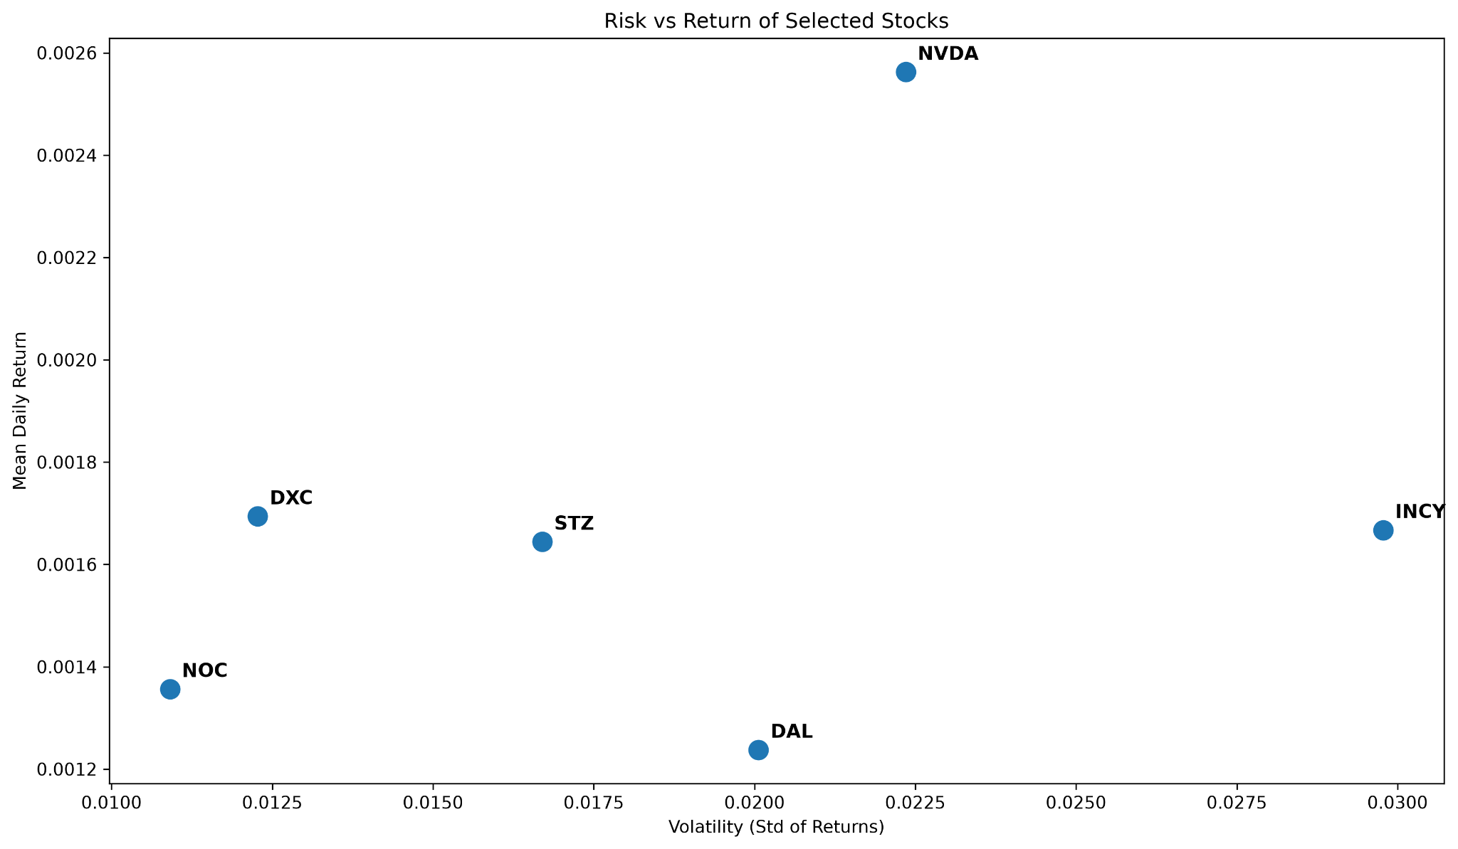
Historical Risk and Return
What the chart shows
The chart shows the average return and volatility of each of the 6 selected stocks. Volatility, measures as the standard deviation of daily returns, is used as an indicator for historical risk.
Key findings
NVIDIA produced the highest average daily return (0.256%), but also had a relatively high volatility (2.24%). NOC had the lowest volatility (1.09%), while INCY had the highest volatility (2.98%) despite a lower average return of 0.167%.
The stocks have a wide variety of risk vs return characteristics, providing the optimisation model a wide variety of assets to choose from when creating portfolios of different risk profiles.

Slide 11
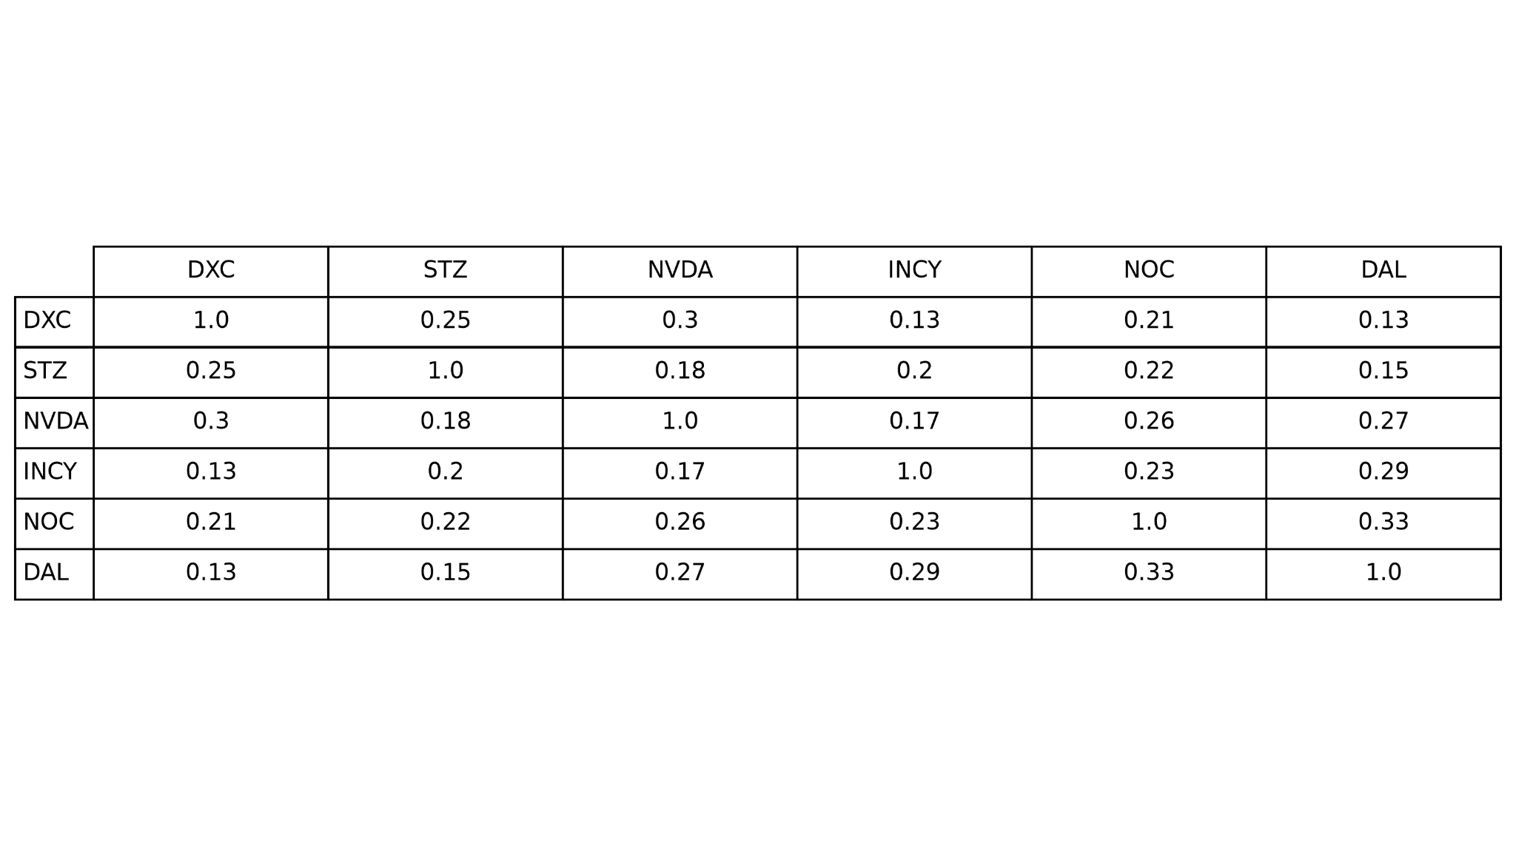
Diversification and Correlation
Correlation shows how strongly two stocks’ daily returns more together in response to market forces. A correlation close to ‘1’ shows a strong positive co-movement, whereas a correlation closer to ‘0’ indicates a weak relationship. Ideally, stocks in a portfolio should not have a strong correlation as you want them to be independent to balance the portfolio, making it more resilient to market forces.
The selected stocks show low to moderate positive correlations, ranging from approximately 0.13 to 0.33. This suggests that the portfolio is well-diversified as the stocks to not move together in response to market forces. This is a result of choosing stocks from a wide range of industries and sectors.

Slide 12
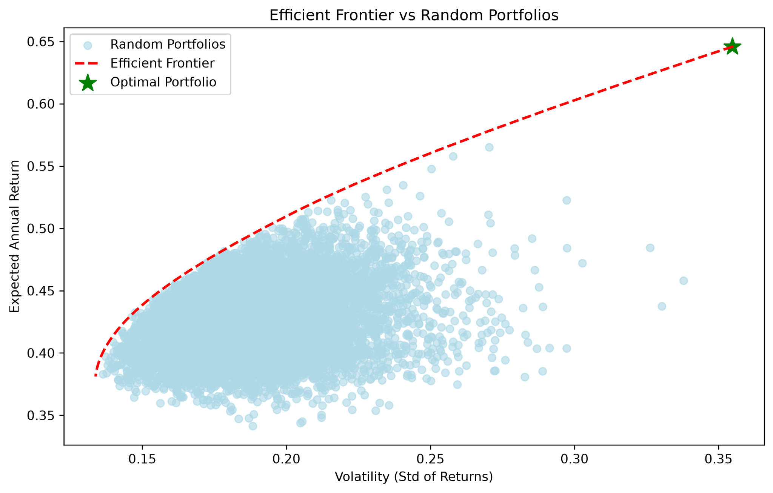
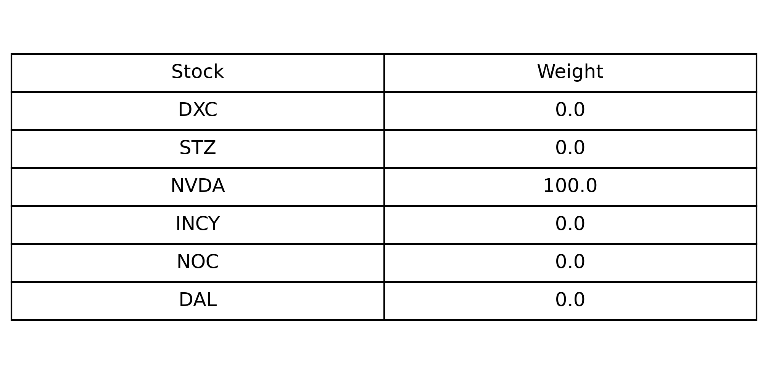
Mean-Variance Optimisation
10,000 random portfolios were generated using random weightings of the 6 selected stocks. The efficient frontier, denoted by the dashed line, identifies the portfolios offering the highest return for a given level of risk.
Mean-variance optimisation was used to identify the optimal portfolio by balancing expected return against portfolio volatility. The resulting portfolio is heavily weighted towards NVDA due to its strong historical returns.
The biased weight towards NVDA is a result of a lack of constraints on the optimisation. As no maximum allocation was implemented, the model was free to allocate the entirety of the portfolio to NVDA.

Slide 13
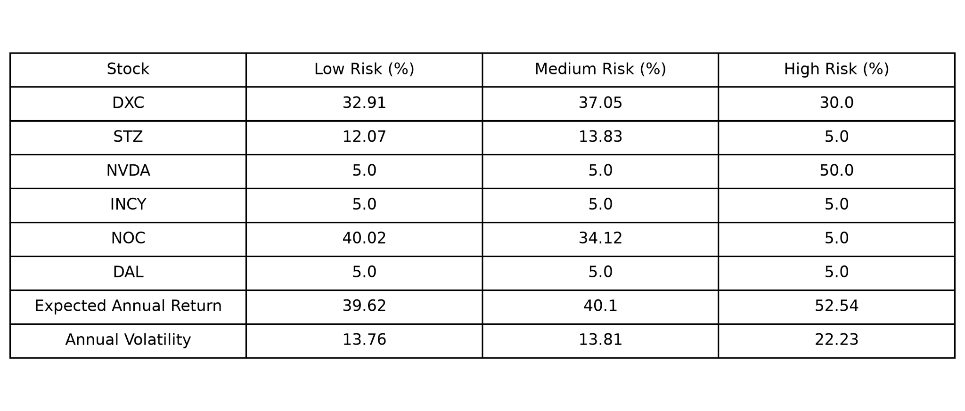
Constrained Optimisation and Portfolio Options
To reduce the dominance of NVDA in the portfolio, constraints were introduced to limit the allocation to individual stocks.
Restraints:
Minimum allocation: 5% per stock
Maximum allocation: 50% per stock
Total allocation: 100%
The low-risk portfolio has the lowest volatility at 13.76% and an expected annual return of 39.62%. It is comprised mainly of NOC and DXC, which have historically low volatility.
The medium-risk portfolio has a volatility of 13.81% and a slightly higher expected annual return of 40.1%. It is also comprised largely of NOC and DXC, but increases the weighting of STZ.
The high-risk portfolio has a significantly larger expected annual return at 52.54%, but a substantially higher risk at 22.23%. This is driven primarily by the 50% allocation to NVDA.

